Slide 1
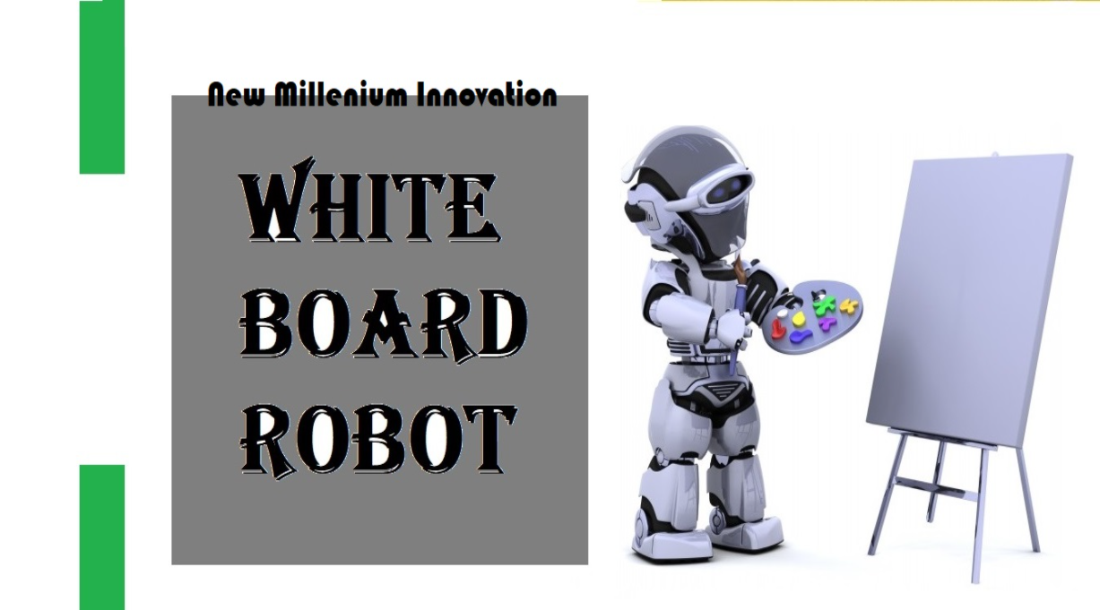
Team 7
Abdulrahman Alzimam
Quincy Ahuja
Siqi Peng
3/5/2021
Notes:
Hello, I am Quincy Ahuja, I am Abdulrahman Alizmam, I am Siqi Peng
This is our capstone project final presentation

Slide 2
Introduction
Our client is Dr. Winfree
Robotics have adopted by many fields including education
Distance learning education is a common thing nowadays
Using a robot to read, write and erase a white board is an advanced form of learning
This project is to develop and design a white board robot
Abdulrahman
Notes:
In this project clients want to work on a robot that will control the whiteboard. As with the advancement in technology, new inventions are developing in the world and people need are changing over the time. Now people want to have as much facilities as they can get, and therefore the demand of robots have increased. Now robots are working in every field of life and soon they are taking places of humans in many working fields. Along with that robots can help in the educational field. In this field robot can do many types of things like from teaching to other physical activities. One of the options is to use a robot for operating the white board, as white boards are used in all type of classrooms, and teachers write on the white board to explain material to the students. This whole process can transform into a digital world where a robot will write on the white board. Now coming to another feature of this robot, that is cleaning the white board and this is one of most tedious work to do as a human, so if a robot will do it, it would be better, therefore writing on the white board and cleaning the white board are two things can be done by the robot. Also, the robot will scan the whiteboard and will upload those documents to the VNC viewer from where the robot can also control.

Slide 3
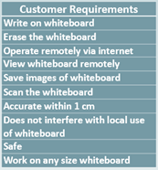
Most Important Requirements
The machine must be able to write on a whiteboard.
The machine must be able to erase the whiteboard.
The machine must be able to scan and save the whiteboard.
All functions must be accessible remotely to the client through the internet.
Siqi
Notes:
When we got the project, we first discussed the requirements with the client, and we summed up a total of ten requirements, such as we need our whiteboard robot can write on whiteboard, erase the whiteboard, and so on.
In our opinion, there are four core functions of robots
For the first requirement, we need our machine must be able to write on a whiteboard. this is the most basic part that our robot needs to have. Only if it can write, it can have the additional function behind. If this is not possible, our design is a complete failure.
And we need our machine must be able to erase the whiteboard. this is an important additional function of our robot. When we finish writing a whiteboard and need to write new content, this function is necessary. This feature would better allow our whiteboard to be used remotely, without the need to wipe the whiteboard.
The machine must be able to scan and save the whiteboard. This function allows our robot to have the ability see what is on the whiteboard and save it as a picture. This let the user know, what is already there before starting a drawing and to save it.
And the last one, all functions must be accessible remotely to the client through the internet. The main feature of the robot is it can be used anywhere from the internet, and we use the Virtual Network Console viewer to achieve this function. This helps with remote learning and convenience.

Slide 4
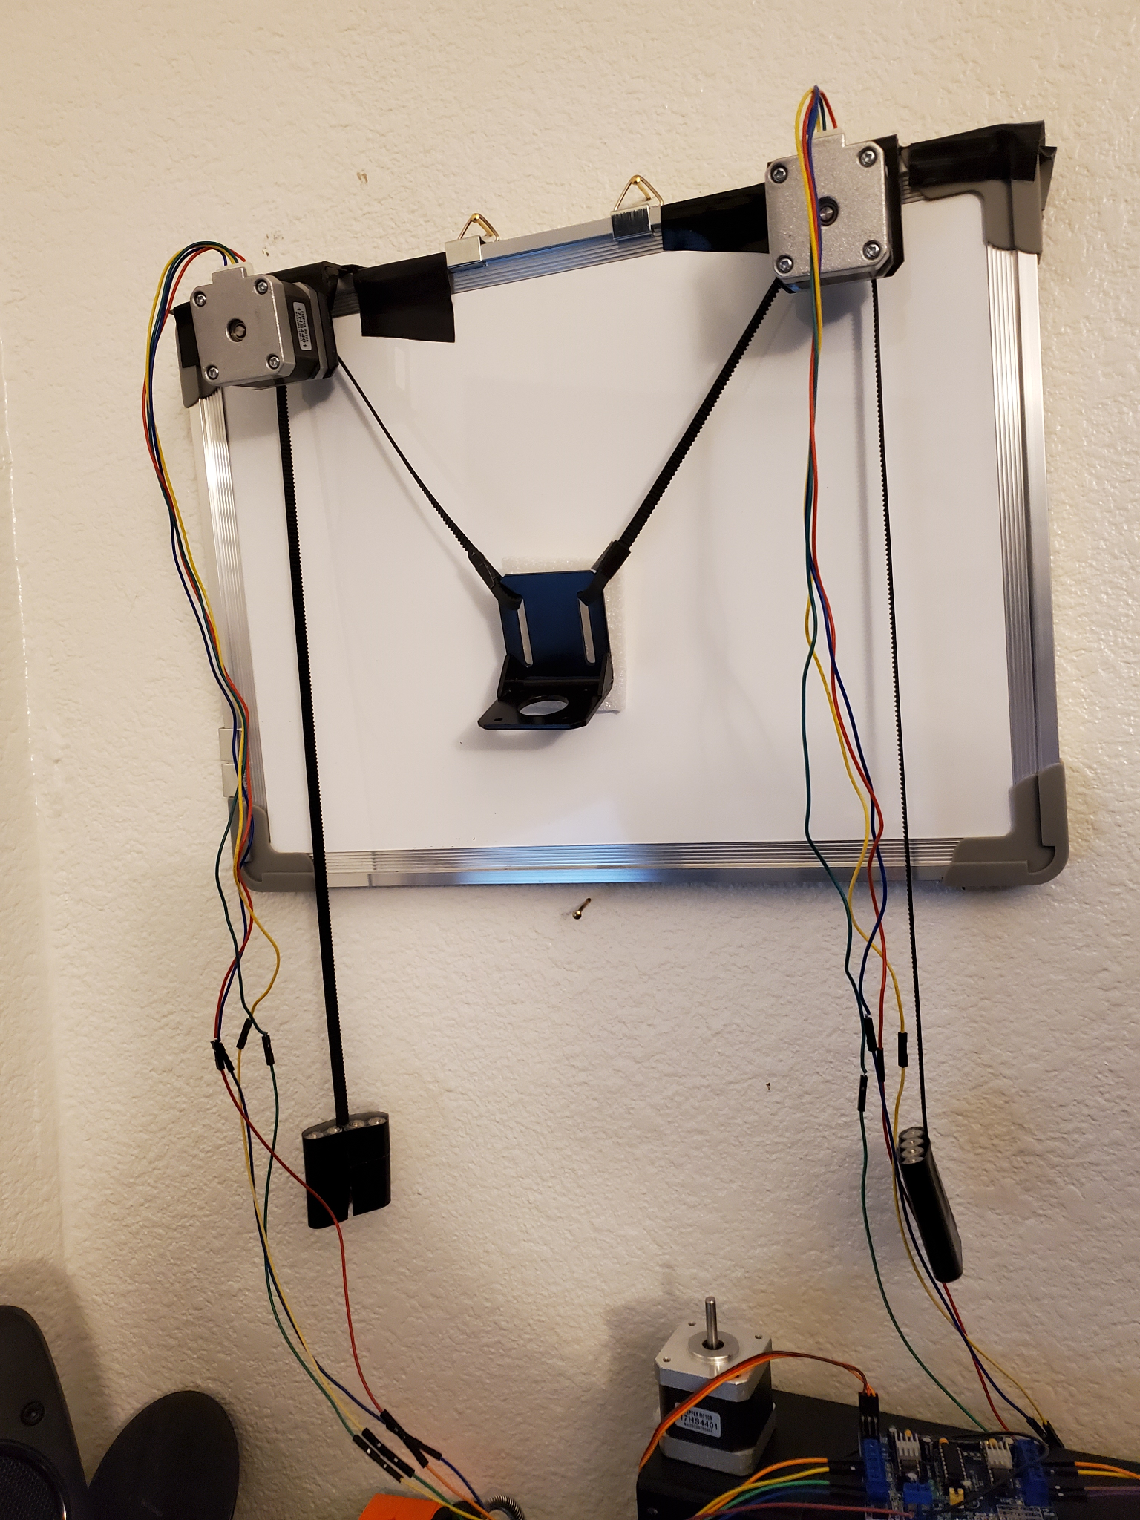
Prototyping
Polar plotter - The method which the robot moves the marker to draw images
Makelangelo - The software used for image processing and motor control
Website - How users were initially to control the robot
Camera - How the robot scans and saves the whiteboard
Quincy
Notes:
When we began design of our project, we prototyped several subsystems to find the best method of implementation for our robot. The first subsystem we prototyped was the polar plotter, as it is the basis of our robot. The prototype is pictured here. This helped us verify our design for the drawing method of our robot.
We also prototyped the control software. The software was important for both image processing and for commanding the polar plotter to draw images. We tested several programs available, and settled on Makelangelo as it fulfilled most of our needs for the robot.
Another system we prototype was a robot control website. Our initial design was to create a website that users could control the robot with. However, our prototyping showed that it would be too complex to implement all functions with the time and experience we had, and so we ended up choosing to control all functions directly from a Raspberry Pi using VNC Viewer.
Finally, we also prototyped the scanning mechanism. Our original design was to mount the camera on the gondola and systematically scan each section of the whiteboard into one complete scan. Yet again, this proved to be to complex to implement with regard to both the hardware and the software. So we ended up settling on a retractable arm mounted above the whiteboard to scan and save the whiteboard.

Slide 5
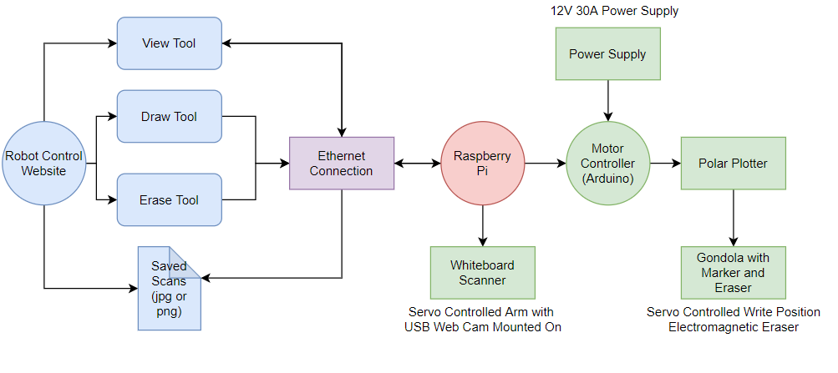
System Architecture
Polar plotter used to trace images to draw them
Servo controls marker position against whiteboard
Camera mounted on retractable arm above whiteboard for viewing and saving
All function controlled by Raspberry pi
Robot is remote controlled through the internet using VNC viewer
Abdulrahman
Notes:
The architecture, as displayed on the slide, looking over the figure, robot controls through the VNC viewer. The `VNC viewer will provide the tools to perform different actions with robot. Different tools include drawing, and erasing and all these commands send to the internet connection which transfer the commands to the robot. Another thing that is present over the VNC viewer is saved scanned documents which transmit from the whiteboard to VNC viewer through the internet. The internet connects to the robot through the Raspberry Pi controller. This Raspberry Pi controller connects with the Arduino and also with the camera and the motors of the arm which moves the camera to complete the scanning. Hence the movement of camera and scanning of board commands comes from the VNC Viewer through the internet to Raspberry Pi and the Raspberry Pi sends it to the servo motors and camera for scanning. Remaining commands goes to Arduino controller, this Arduino controller connects with the polar plotter to perform the tasks like drawing or erasing. The polar plotter connects further with gondola with marker and eraser, which performs the actual drawing and erasing actions. The power supply provides to the Arduino controller which splits the power to the components including polar plotter and camera, and also to the gondola. Hence all the components connects through the internet and got the power as well. In this way the robot and VNC viewer application interlink and works together.

Slide 6
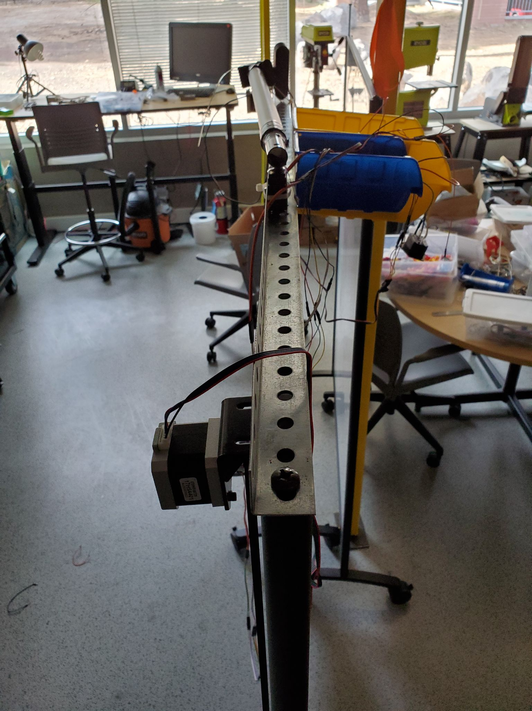
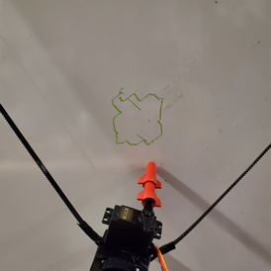
Testing Results
Robot is able to draw images on the whiteboard
Functional scanning mechanism
Fully controllable over the internet
Less accurate than minimum requirement
Ineffective eraser mechanism
Quincy
Notes:
We tested each requirement of our robot after our design was complete. Our most important tests were testing the drawing capabilities and accuracy of the robot, testing the eraser, testing the scanning mechanism, and testing the internet controllability of the robot. For our drawing and accuracy test, we had the robot draw a square that was supposed to be 10x10 cm. We noticed the motors tend to fluctuate, causing inaccuracies in the drawings as can be seen in the right most picture. We tested the eraser mechanism by commanding the robot to erase sections of the whiteboard, and found that with our current design, the eraser does not make sufficient contact with the whiteboard and so is ineffective. We also tested the camera scanning mechanism, as well as the internet connection which both passed our tests to meet the requirements.

Slide 7
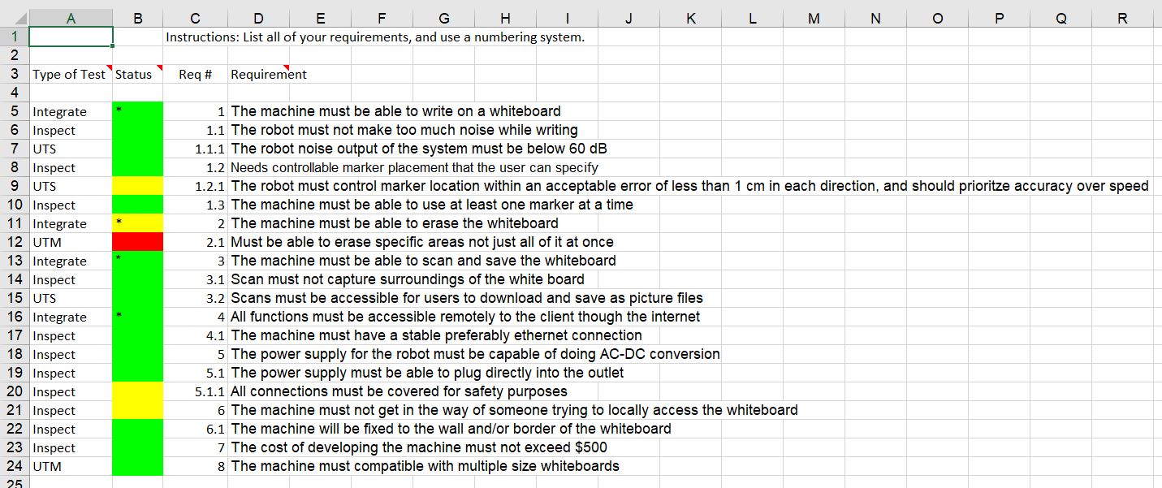
Analysis of Results
All function controlled by Raspberry pi
Raspberry Pi accessible through internet via VNC Viewer
Robot is not as accurate as required, possibly to due the power supply
Eraser mechanism needs a stronger electromagnet or redesign
Siqi
Notes:
After we finished all the tests, We did a comprehensive analysis and sorted out what the project needed to improve. Our analysis of all the test results is as follows:
One of the main tests was the Polar Plotter Precision Test. As Quincy just said, the purpose of this test is to verify the drawing accuracy of the robot. Our test result failed, and the reason was summarized as: the motor was no synchronized. However, we also noted that, if we drawing a larger image, it will usually results in a higher accuracy, so we suspect that power supply is not always sufficient, and if we want to update our machine, we need to change a set of electrical equipment, that mean we need to change the motor and the power supply.
The other major test we did was the noise test, which required the robot to be no louder than 60 decibels, which we successfully accomplished.
Another major test that is worth to analyzing is: the basic test that the whiteboard robot needs to do, that is, all the subsystems work together so that the robot can write on the whiteboard, scan and save the whiteboard, and erase the whiteboard over the Internet.
All the steps worked except for the eraser.For the analysis of this test result, we believe that the contact between the electromagnet in the eraser and the white board is not enough. We can use a stronger electromagnet or other equipment to fix it to increase the contact with the white board.
Overall, the project performed decently under the testing. Some of the requirements were not met exactly, especially the accuracy of the robot and the erasing mechanism. However, we feel that both of these issues could be fixed by using a stronger power supply and redesigning our eraser mechanism.

Slide 8
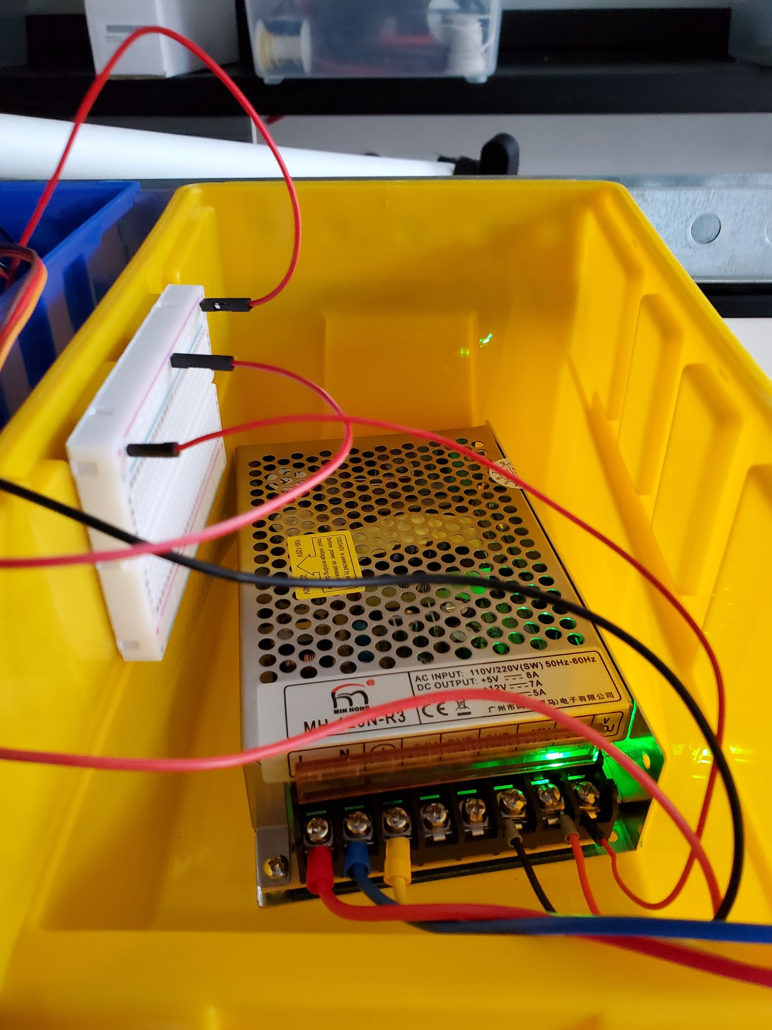
Technical Challenges
Physical construction
Website development
Software integration
Designing a robot that meets all functional requirements while still remaining out of the way
Quincy
Notes:
Throughout this project we faced many technical challenges that we had to solve. Firstly, the physical construction of the robot and mounting it to the whiteboard was more difficult than we first thought. We initially designed the robot to be mounted on the wall around the whiteboard, however the whiteboard our client wanted us to build the robot on was a portable whiteboard on wheels. This meant there was no wall for us to attach things to, and so we had to come up with new ways to mount all of the hardware.
Another challenge we faced was developing a website to control the robot. We spent a lot of time trying to figure out all of the coding and development to create a website that users could control the robot from. However, this proved to be too difficult given the time and experience we had, and we had to figure out another way to control the robot through the internet, which lead us to using VNC Viewer.
We also had unforeseen difficulties integrating our control software with our robot. The software is made to run on many different types of machines and controllers, and so has to adapted to each one. Ours was no different, however there was very little documentation on how it should be done, and so we were mostly left to trial and error. We tried several different motor controllers, several different versions of firmware, and several different versions of software. Once we got that working, we then had to get it working again on the Raspberry Pi. Our initial integration did not work on the Raspberry Pi and we ended up needing to use yet another version of the software, leading to another cycle of testing motor controllers and firmware. Eventually however, we were able to get all parts of the software integrated into the robot and set everything up correctly.
It was also difficult to design our robot to meet all the operational requirements while still being able to store out of the way when not in use as required. We were not able to implement several of our initial designs for an eraser and a scanner, as they would have ended up interfering with people trying to use the whiteboard.

Slide 9
Conclusion
White board robot has been developed
Polar plotter can move in two dimensional axis and can place marker at any point
Robot can use in distance learning programs
It can control through the internet with VNC Viewer
Most of the engineering requirements have been fulfilled by the design
Overall, our client is satisfied with our project
Special thanks to Mr. Han, Dr. Severinghaus, and Dr. Winfree
Abdulrahman
Notes:
To conclude this presentation, our project is done and we have developed the white board robot. This robot is working according to the requirements of client like it write and scan the whiteboard using the robot polar plotter which moves at any point over the white board, this robot can help in distance learning programs. Anyone across the globe can access the robot and see the scanned documents and study through it. Hence it can be stated that most of the engineering requirements have been fulfilled by the design and overall the client is satisfied with our design. This was a design project and from this project we have learned how to work professionally over the design projects. Special thanks to our client Dr. Winfree for giving us this project, as well as Han and Dr. Severinghaus for teaching and helping us through this project.

Slide 10
Project Demonstration
Quincy

